Slide 1





Native Component
Fauzi Sholichin
fauzisholih@gmail.com
+6289673732142
https://www.linkedin.com/in/fauzisho/

Slide 2
Introduction
Recap: Create New Project
Choosing the right Package/Library
Adding plugin and installing library
Barcode Scanner Basic
Deploy to Device
Generate custom barcode/qr code
Add Platform Feature
Customize barcode scanner component

Slide 3
Creating a new project
Ionic start barcode-scanner blank
cd ionic barcode-scanner
Ionic serve --lab
! Recap
-Ionic 4 beta? No, we are using ionic 3 only
-Ionic Pro? No, not full backend integration
-@ionic/lab? Yes, we use it to display lab layout
-@ionic/app-script? Yes, we use it to run short script

Slide 4
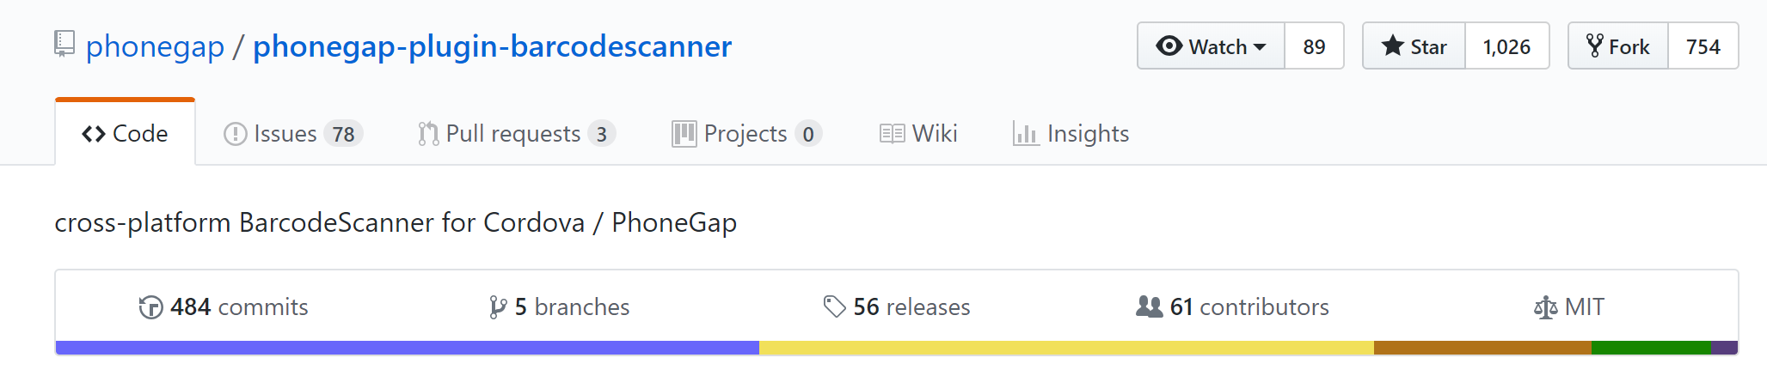
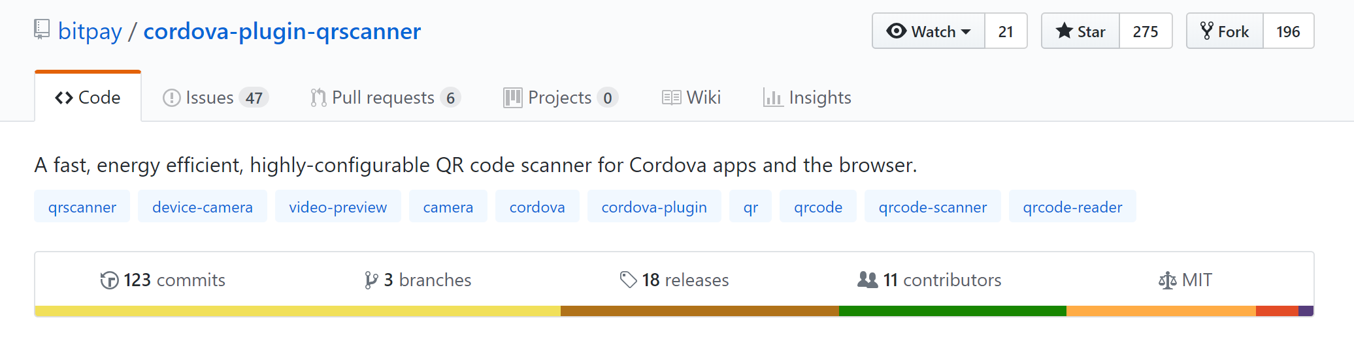
Quick tips – Which one to choose?
https://github.com/phonegap/phonegap-plugin-barcodescanner
https://github.com/bitpay/cordova-plugin-qrscanner

Slide 5
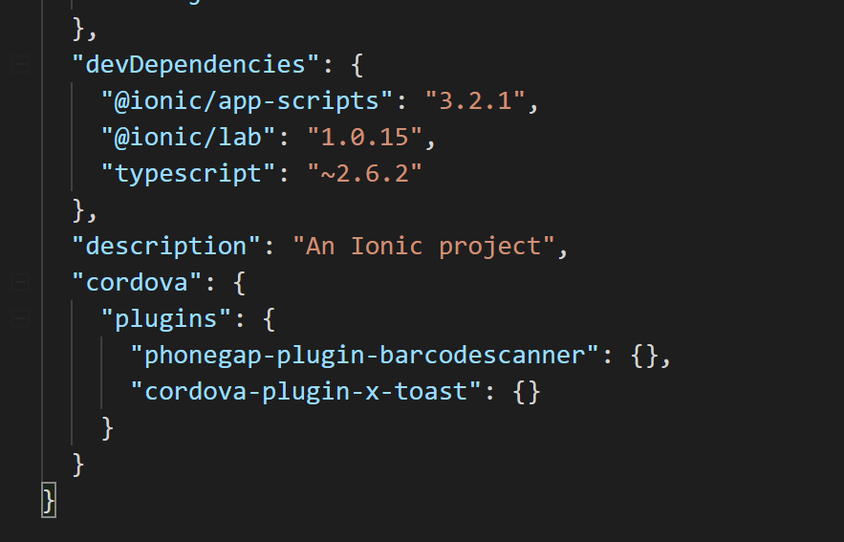
Adding plugin and installing library
ionic cordova plugin add phonegap-plugin-barcodescanner
npm install --save @ionic-native/barcode-scanner
ionic cordova plugin add cordova-plugin-x-toast
npm install --save @ionic-native/toast
package.json

Slide 6
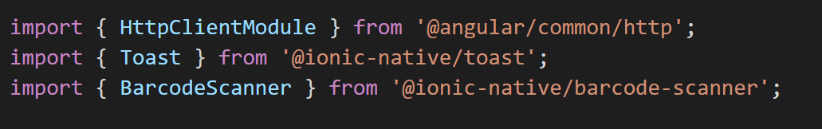
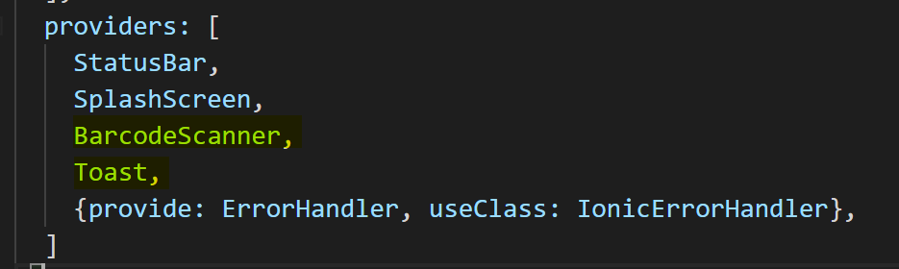
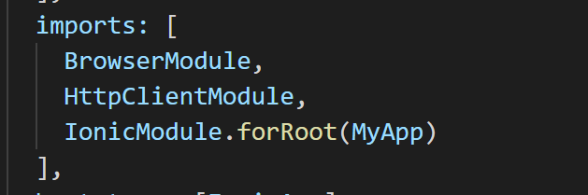
Basic barcode scanner
src/app/app.module.ts

Slide 7
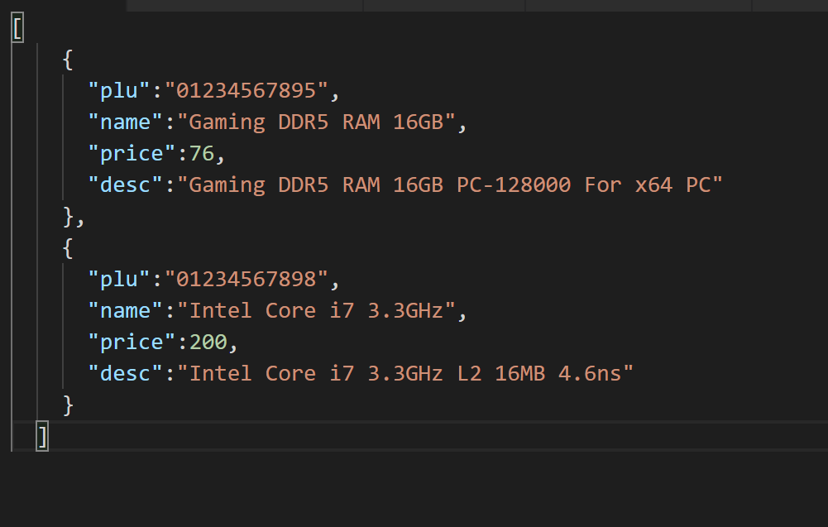
Basic barcode scanner
mkdir src/assets/data
touch src/assets/data/products.json
src/assets/data/products.json

Slide 8
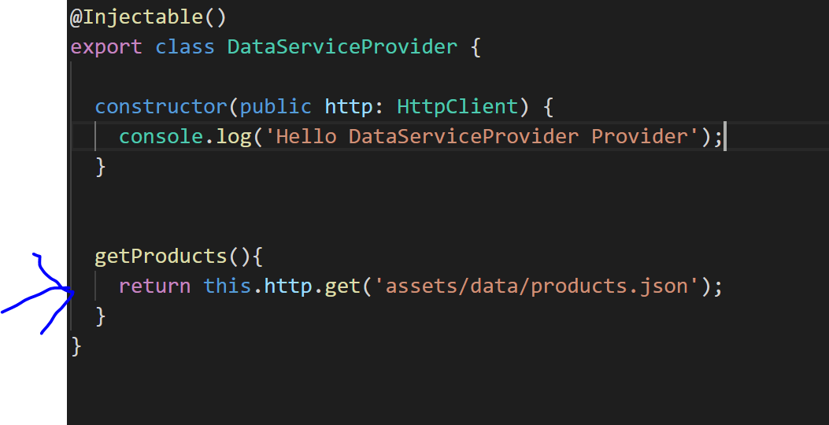
Basic barcode scanner
ionic g provider DataService
Add getProducts() function
/src/providers/data-service/data-service.ts

Slide 9
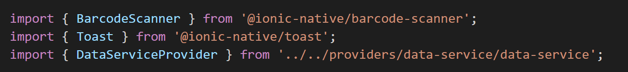
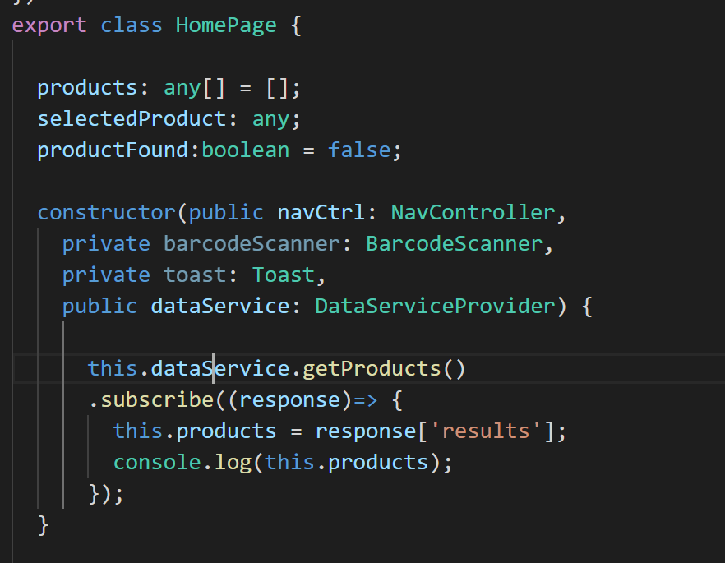
Basic barcode scanner
src/pages/home/home.ts

Slide 10
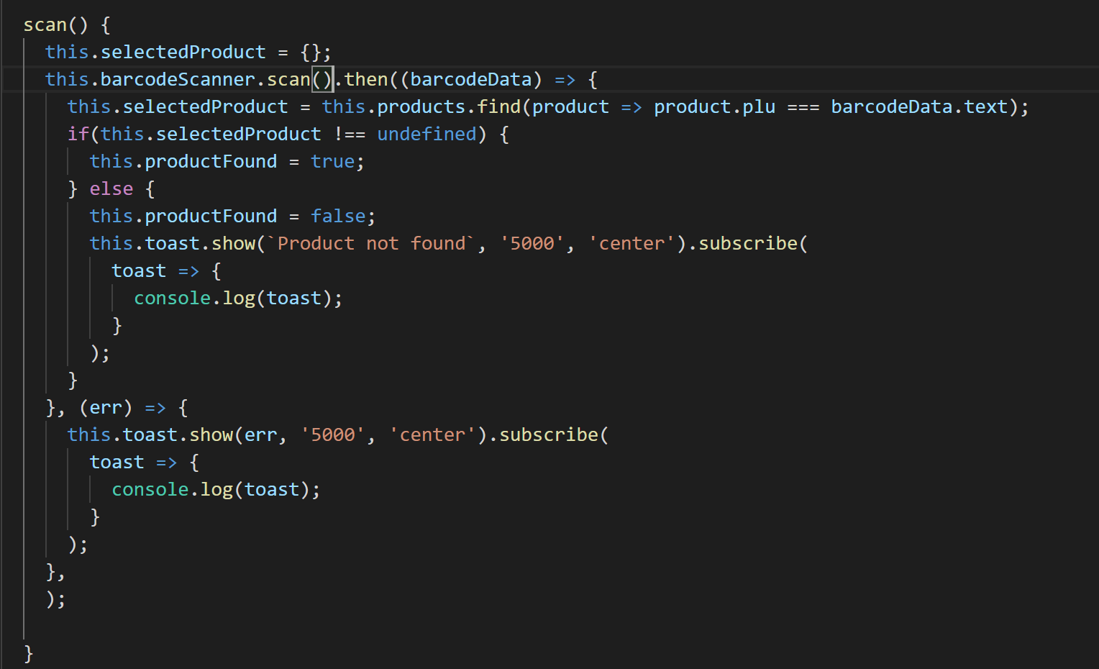
Basic barcode scanner
src/pages/home/home.ts

Slide 11
Deploy to Test Device
ionic cordova platform add android
Ionic cordova run android

Slide 12
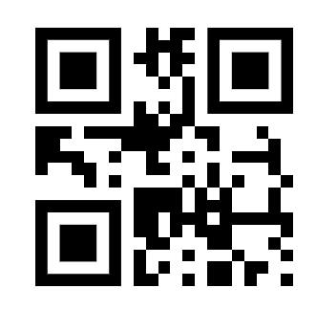

Generate QR codebar or Barcode
Customize and generate your own barcode
http://www.qr-code-generator.com/
https://barcode.tec-it.com/

Slide 13
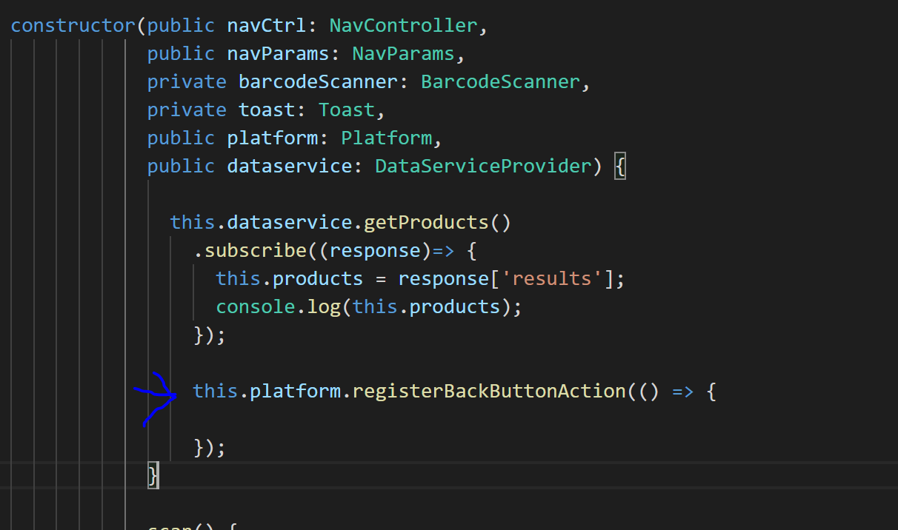
Add Platform feature (back button)
src/pages/home/home.ts

Slide 14
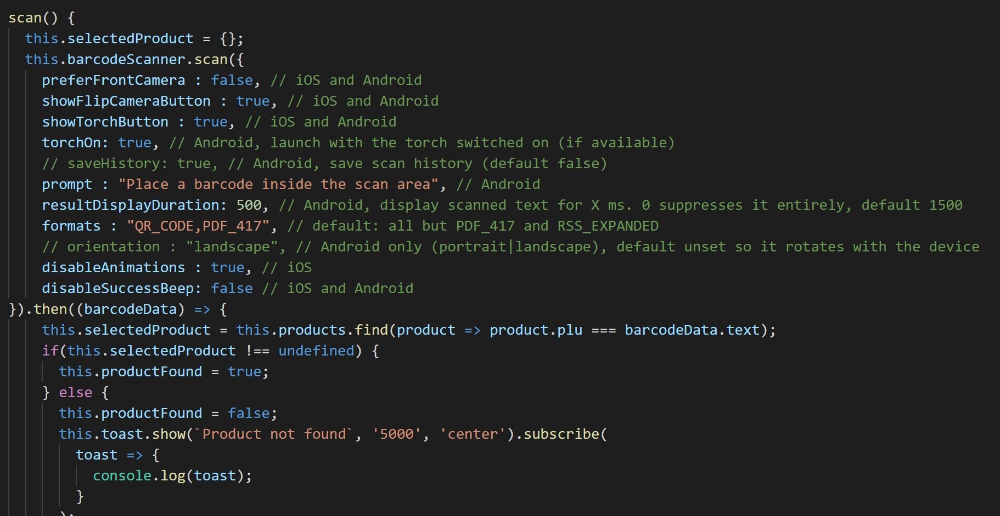
Customize barcode scanner component
https://ionicframework.com/docs/native/barcode-scanner/
src/pages/home/home.ts

